Slide 1
Week 8 (2) – Introduction to Dynamic Programming
CST370 – Design & Analysis of Algorithms
Dr. Byun
Computer Science

Slide 2
Lecture Objectives
After completion of this lecture, you will be able to
  describe basic ideas of dynamic programming technique.
  apply the dynamic programming technique to solve a simple problem.

Slide 3
Dynamic Programming
Dynamic programming is an algorithm design technique for solving a problem with overlapping subproblems.
  This technique was invented by Richard Bellman in the 1950s.
  Here “programming” means “planning”.
    It is not related to computer programming.
This lesson describes a simple example using dynamic programming.
  Note that the problems to be solved in dynamic programming techniques are generally defined by recurrence.

Slide 4
Computing the nth Fibonacci Number
Fibonacci numbers are the numbers in the following integer sequence and characterized by the fact that every number after the first two is the sum of the two preceding ones.
  0, 1, 1, 2, 3, 5, 8, 13, 21, 34, …
We can define the sequence by a simple recurrence.
  F(0) = 0
  F(1) = 1
  F(n) = F(n-1) + F(n-2) for n >= 2

Slide 5
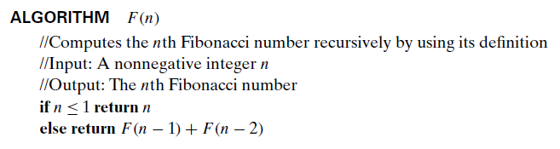
Computing F(n): Brute-Force Approach
To identify the Fibonacci number, F(n), for an integer n, you can develop it using the simple brute-force method:

Slide 6
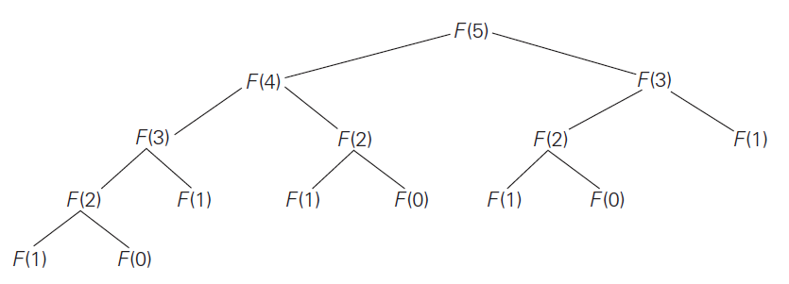
Computing F(n): Brute-Force Approach
A drawback of the recursive algorithm is that you have to solve overlapped subproblems multiple times.
  For example, if you calculate F(5), the algorithm must calculate F(0) three times and F(1) five times.

Slide 7
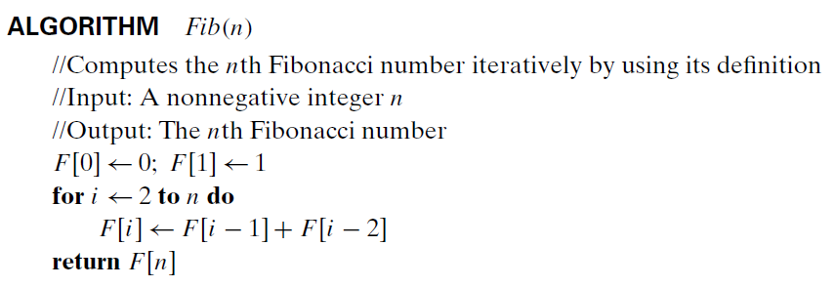
Computing F(n): Dynamic Programming
You can compute F(n) using “iteration and record (= dynamic programming)” approach.
  To avoid multiple calculations of the sub-problems, this technique prepares an array to maintain the solution of the sub-problems.

Slide 8
Dynamic Programming – Basic Idea
In the lecture, we will cover more complex problems to solve using the dynamic programming approach.
This is the basic idea of the approach.
  Set up a recurrence relation that presents a solution to a problem with smaller sub-problems.
  Solve the smaller sub-problems and record the solutions in a table.
  Solve the original problem using the table.

Slide 9
<<< Course Instruction >>>
Read pages 283-284 in the textbook and proceed to the next slide.
  This section introduces the general concept of dynamic programming.

Slide 10
Chapter 8: Dynamic Programming
8.1 Three Basic Examples
8.2 The Knapsack Problem and Memory Functions
8.3 Optimal Binary Search Trees
8.4 Warshall’s and Floyd’s Algorithms

Slide 11
Coin-Row Problem
Read the following document and understand the basic idea to solve the problem.
  https://goo.gl/7LS6ZN

Slide 12
<<< Course Instruction >>>
Read pages 285-286 in the textbook and proceed to the next slide.
  If you have a thorough understanding of the Google document, this should be straightforward.
  However, to show the coins that make up the maximum amount F(n), this textbook describes backtracing.
    You should understand that section.

Slide 13
Exercise
Assume that you have five coins with the values 3, 2, 3, 2, 1.
  Fill out the table to find F(5).
Do not see the answer immediately.
  Try to solve it by yourself.
Index | 0 | 1 | 2 | 3 | 4 | 5
C_{i} | NA | 3 | 2 | 3 | 2 | 1
F(i)

Slide 14
Solution
Index | 0 | 1 | 2 | 3 | 4 | 5
C_{i} | NA | 3 | 2 | 3 | 2 | 1
F(i) | 0 | 3 | 3 | 6 | 6 | 7
From the recurrence of the problem, F(0) ~ F(5) can be calculated as follows.
  F(0) = 0 // initial condition
  F(1) = 3 // initial condition
  F(2) = max {F(0)+c₂, F(1)} = max {0+2, 3} = 3
  F(3) = max {F(1)+c₃, F(2)} = max {3+3, 3} = 6
  F(4) = max {F(2)+c₄, F(3)} = max {3+2, 6} = 6
  F(5) = max {F(3)+c₅, F(4)} = max {6+1, 6} = 7
We will pick c₅, c₃, and c₁ to get the maximum amount 7 with backtracing.

Slide 15
<<< Course Instruction >>>
Read pages 288-290 (Example 3) in the textbook and proceed to the next slide.
  This is an optional reading.
  But, it’s a very interesting problem which can be solved using a dynamic programming algorithm.

Slide 16
<<< Course Instruction >>>
This lecture is over.
  When you are done, study the next lesson (week_8_3.ppt) on the iLearn.

